Slide 1
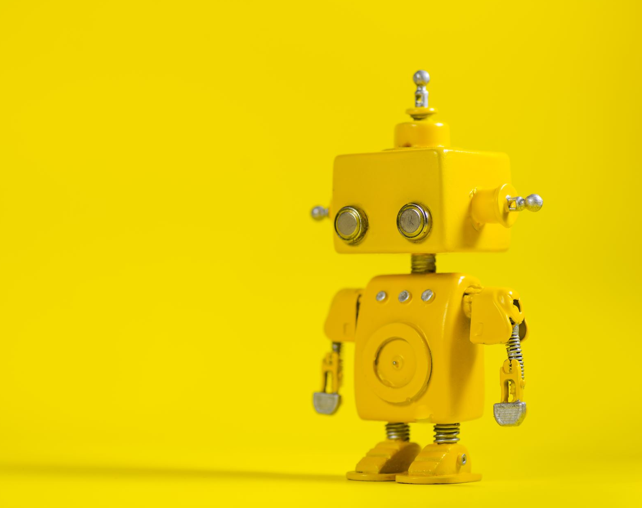
Artificial Intelligence

Slide 2
Artificial Intelligence
What is intelligence
What is artificial intelligence
History of artificial intelligence
Difference between human intelligence and machine
Type of A.I.

Slide 3
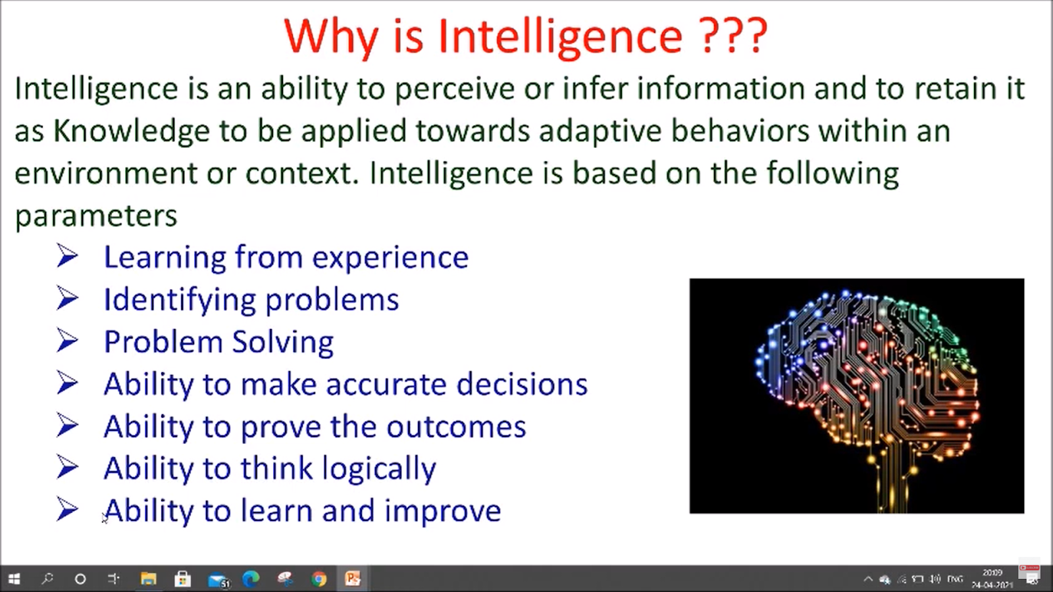
What is intelligence

Slide 4
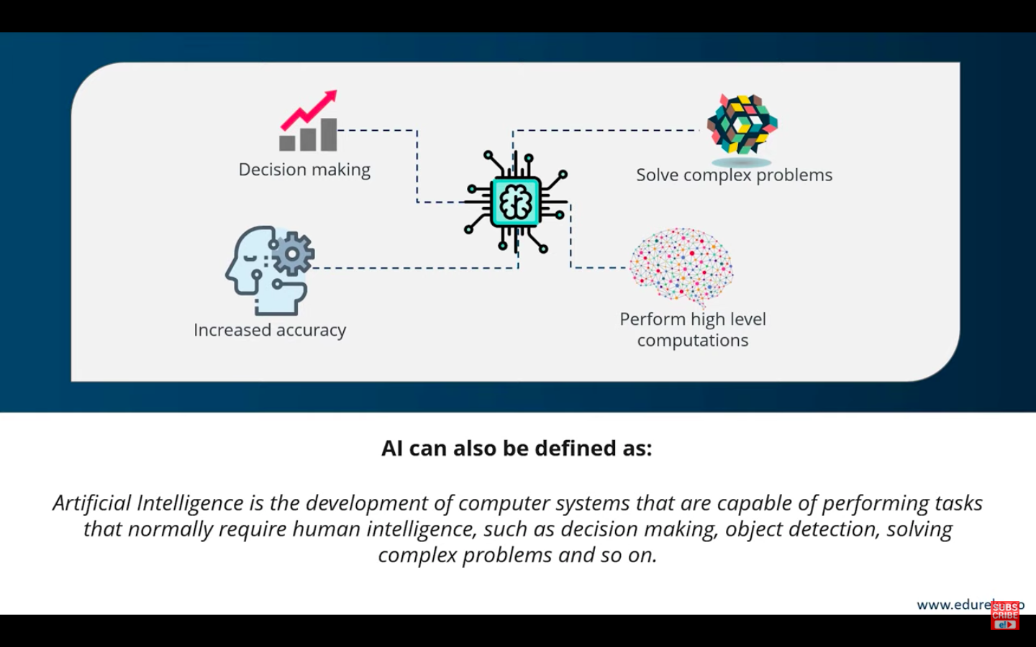
Artificial Intelligence

Slide 5
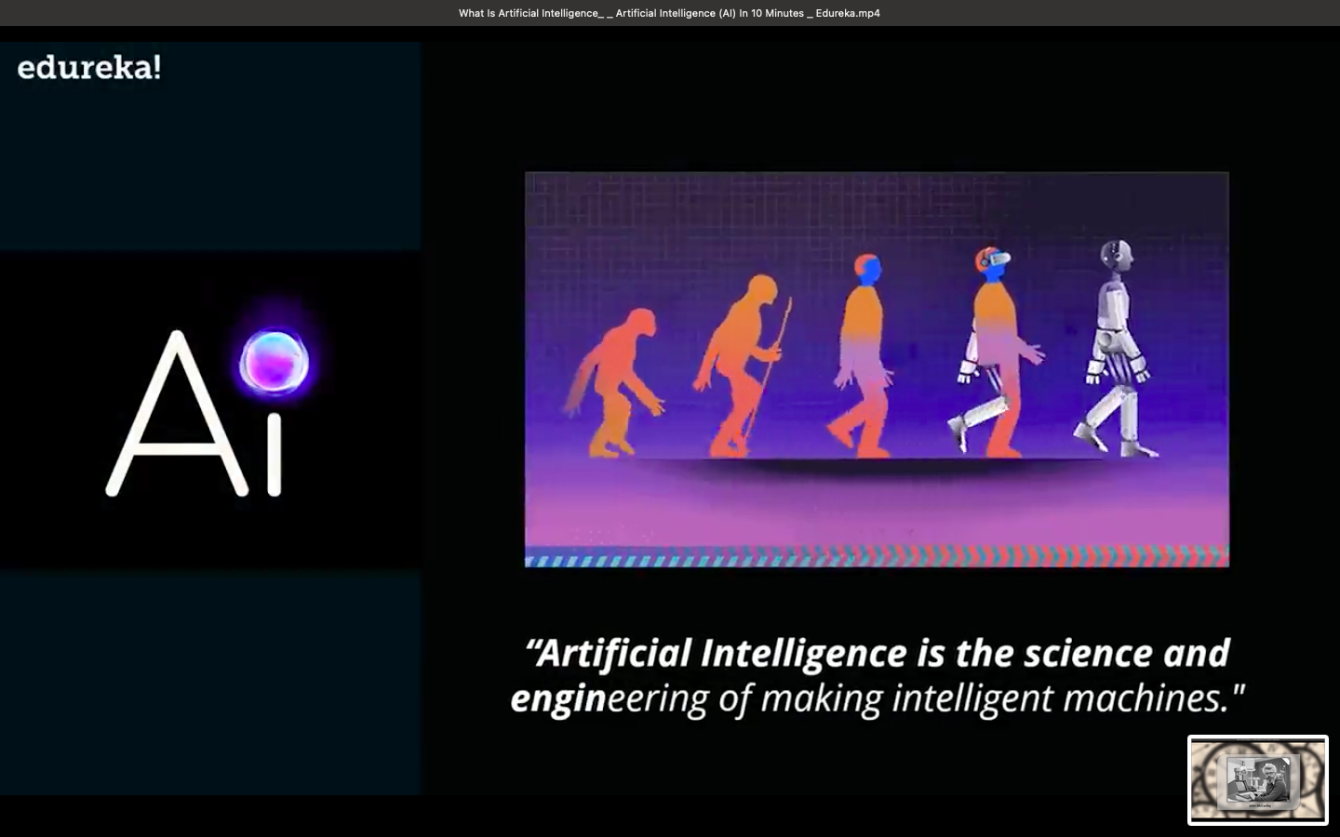

Slide 6
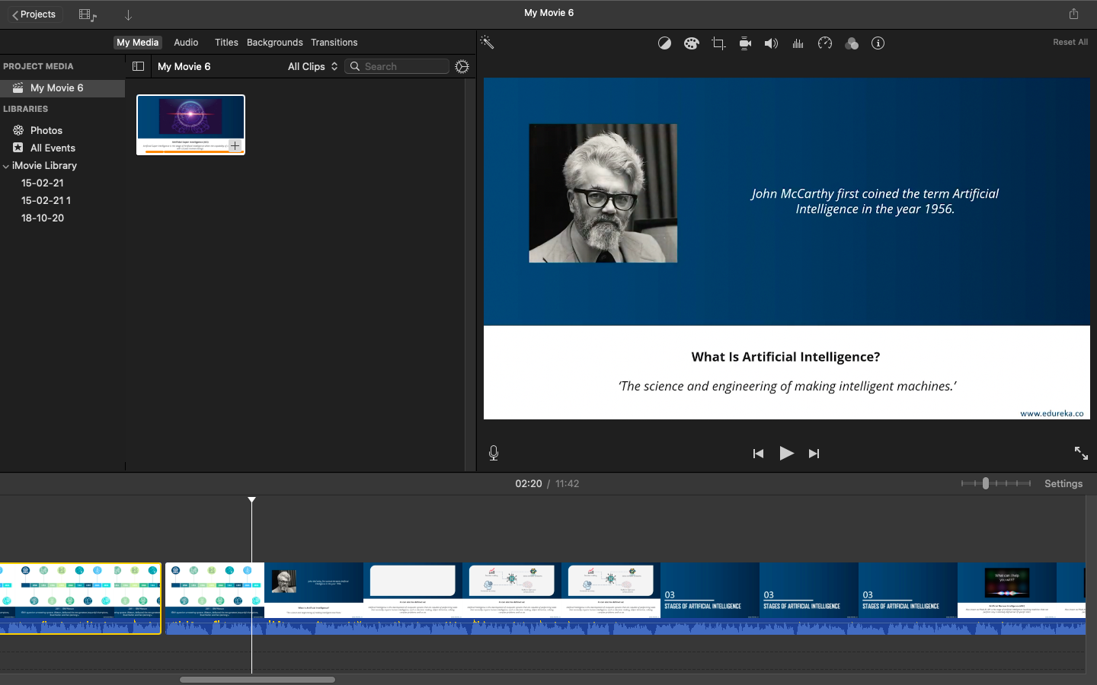
INVENTOR OF ARTIFICIAL INTELLIGENCE

Slide 7
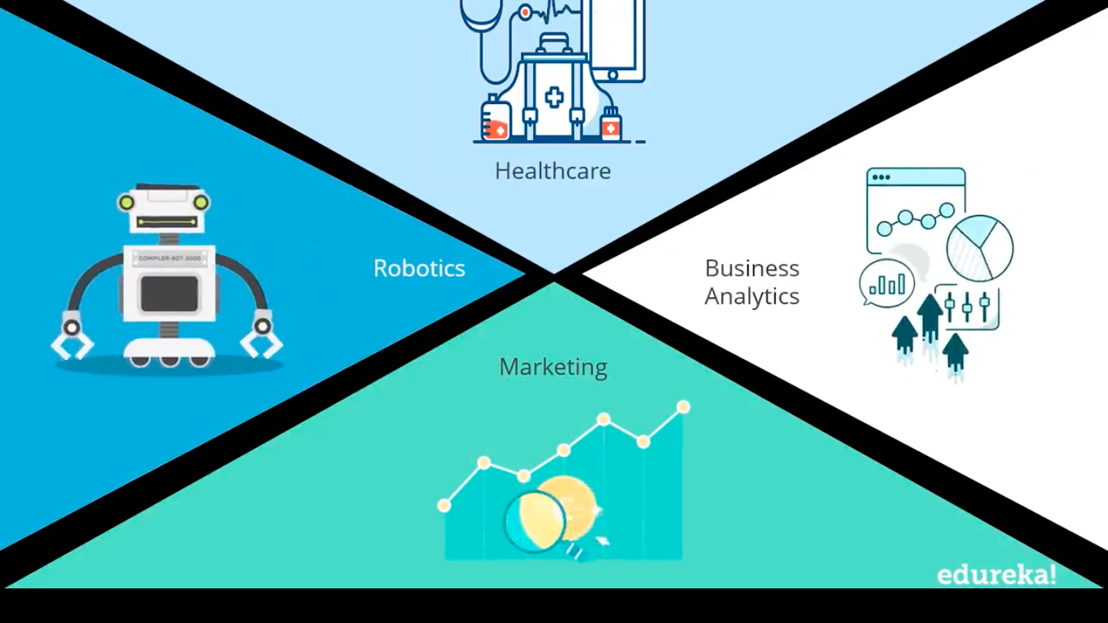

Slide 8
Difference between human and machine intelligence
HUMAN INTELLIGENCE | MACHINE INTELLIGENCE
1. Humans perceive by patterns | 1. The machines perceive by set of rules and data.
2.Humans store and recall information by patterns. For example, the number 40404040 is easy to remember, store, and recall as its pattern is simple. | 2. Machines has memory that can store and recall the information by searching algorithms.

Slide 9
WHY AI TODAY
Artificial intelligence is a buzz word today ,in the field of computer science? The simple reason is that today we are technologically more advance and ready for better research.
We have computer with faster computational power.
We are now becoming able to program.
Computers in much better way with complex and intelligent algorithm.

Slide 10
Types of A.I
Artificial intelligence
Type-1
Type-2
Narrow A.I.
General A.I
Strong A.I
Reactive
limited
Self awareness

Slide 11

Examples of artificial intelligence

Slide 12
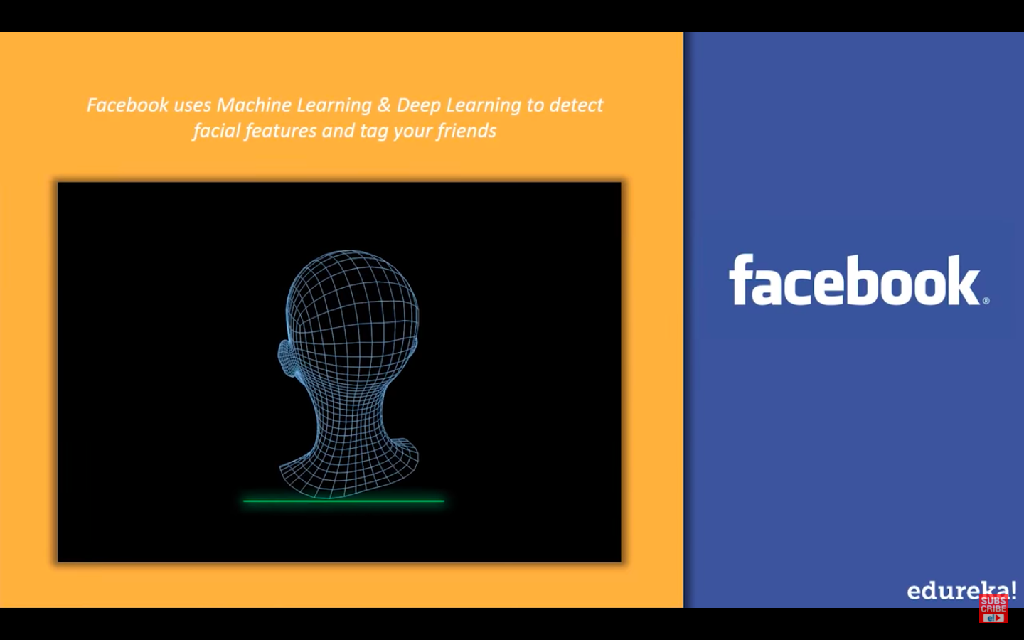
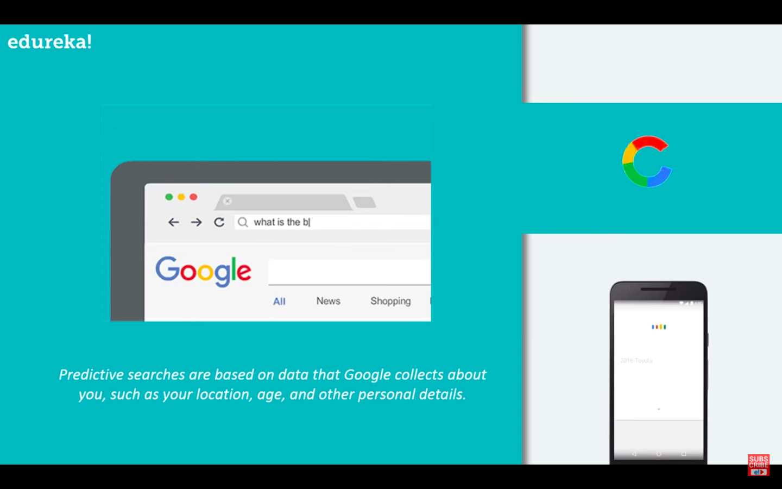

Slide 13
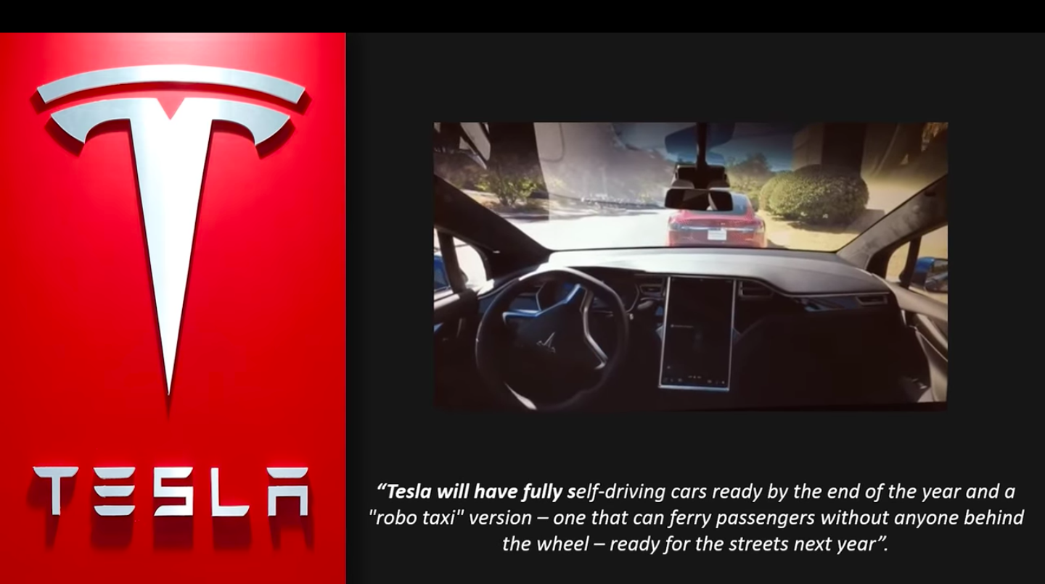

Slide 14
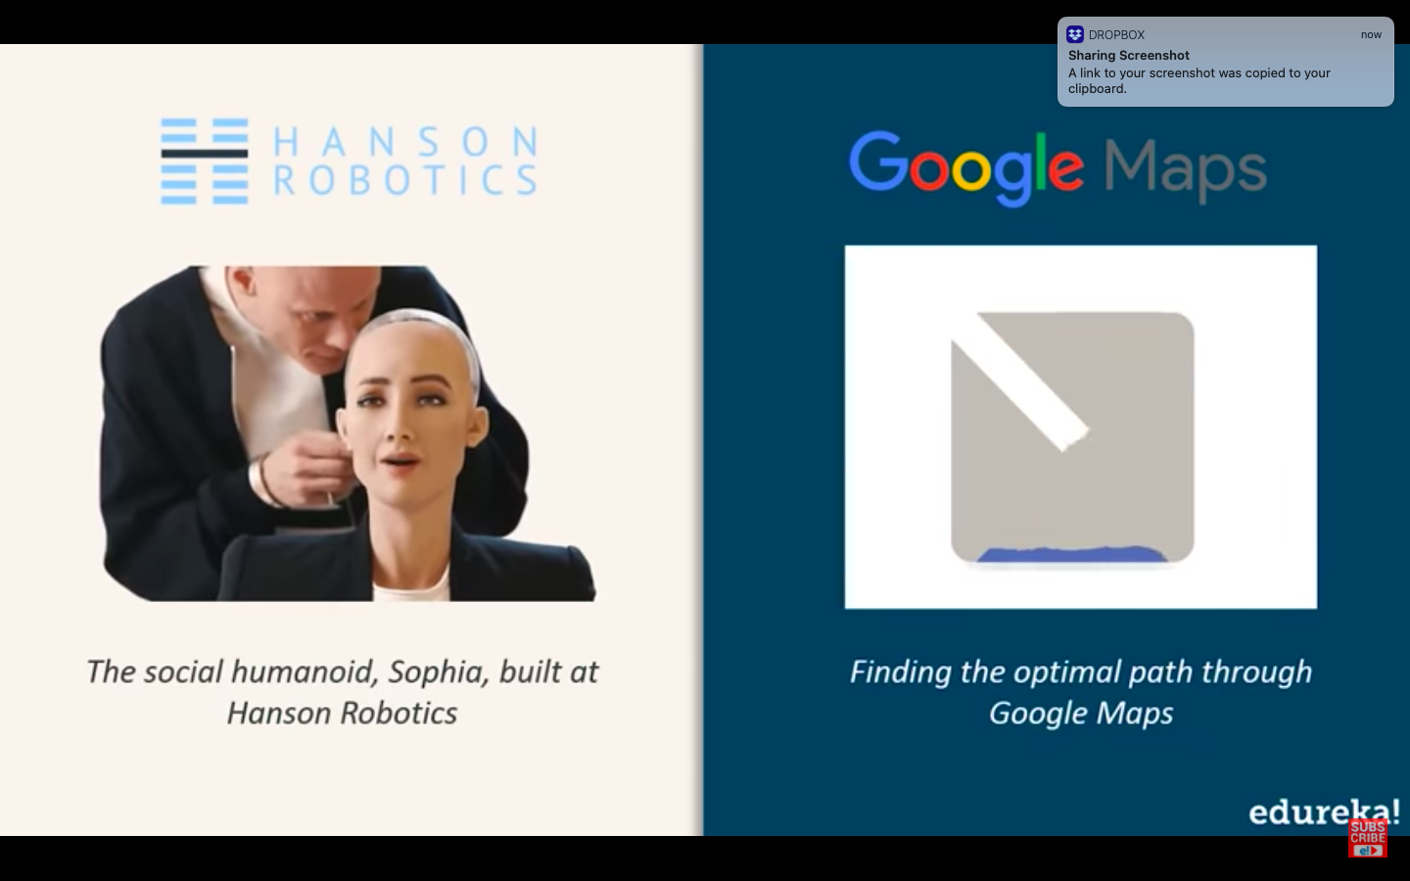

Slide 16
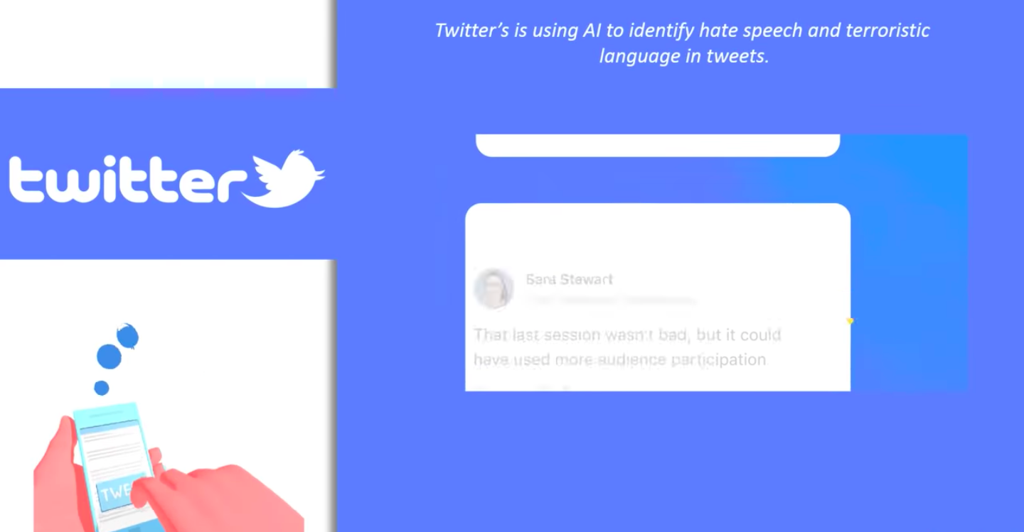

Slide 17
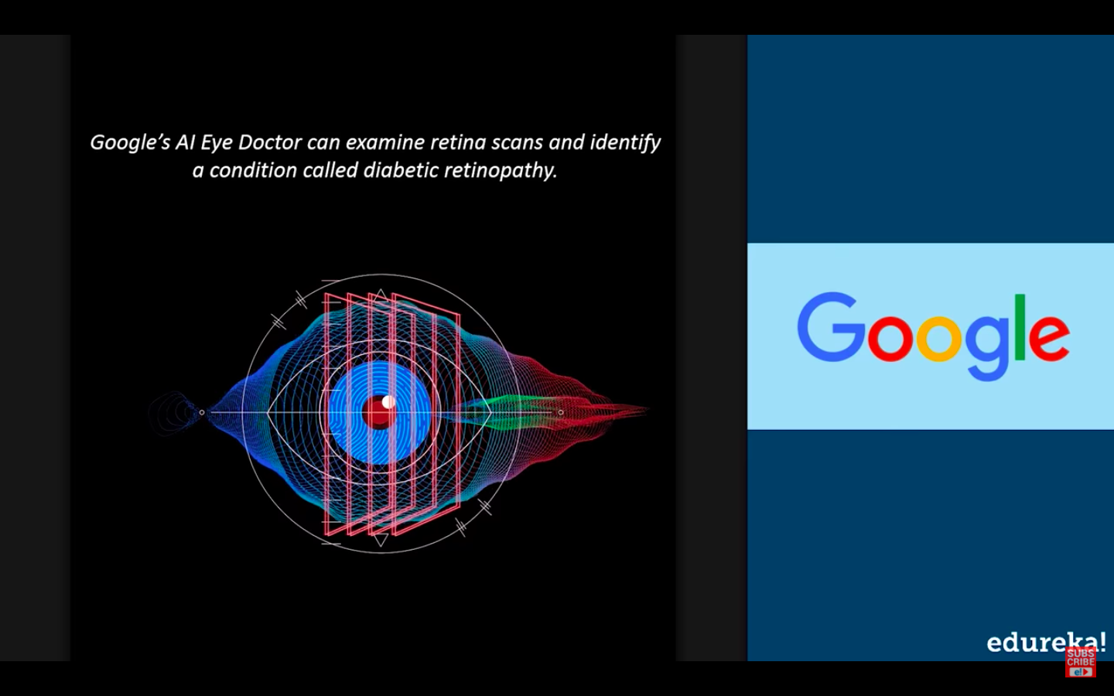

Slide 18
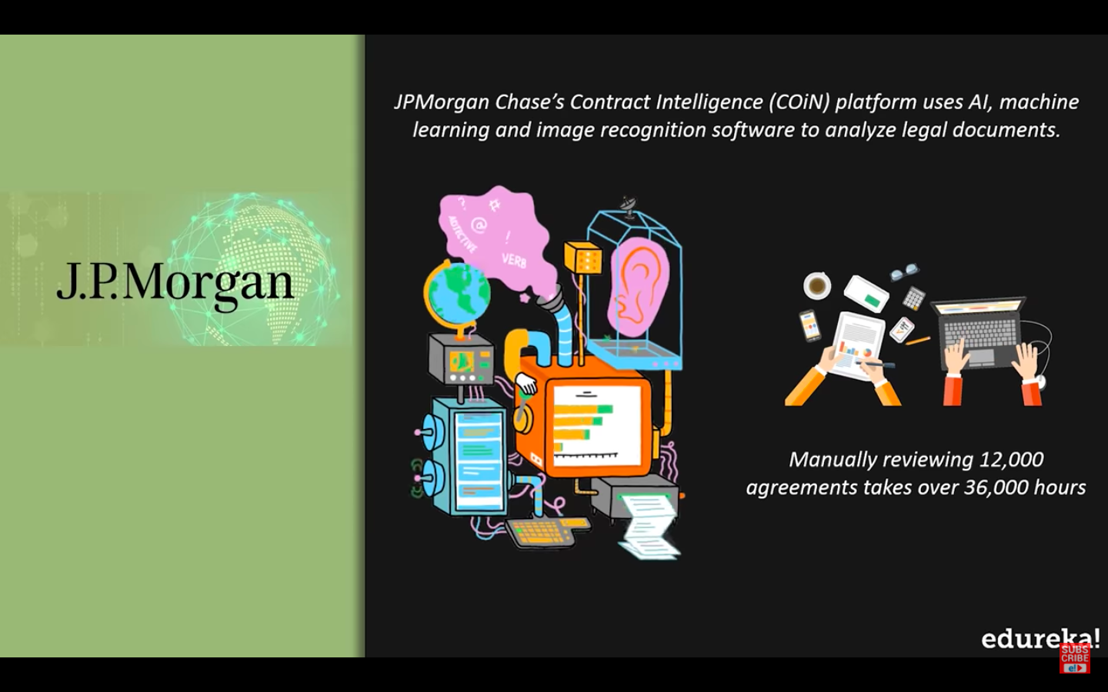

Slide 19
